Slide 1
BIG DATA-HOMEWORK PRESENTATION DATA DOMAIN- TWITTER
PRESENTED BY-
PRIYAL AGARWAL(303202749)
SANYA MITTAL(304373464)

Slide 2
ABSTRACT
Compare the popularity of programming languages .
Retrieve programming tutorial links.
Popularity of programming languages
Python
Javascript
Ruby
Tutorial Links

Slide 3
Text Mining
Text mining is an application to process natural language and it contains analytical methods to text data in order to derive relevant information.
This data can be used in different use cases such as finding trends related to a specific keyword, measuring brand sentiment, and gathering feedback about new products and services.

Slide 4
Python libraries
Four Python libraries
Json : For parsing the data
Pandas:For data manipulation matplotlib for creating charts
Re:For regular expressions.
D3 :Allows to create some wonderful interactive visualisations.
Vincent:Bridges the gap between a Python back-end and a front-end that supports D3.js visualisation

Slide 5
Text Mining using Twitter Streaming API and Python
Reading Tweets
Structuring Tweets
Analyzing Tweets by Language
Analyzing Tweets by Country
Adding programming languages columns to the tweets DataFrame
Analyzing Tweets by programming language
Targeting relevant tweets
Extracting Links

Slide 6
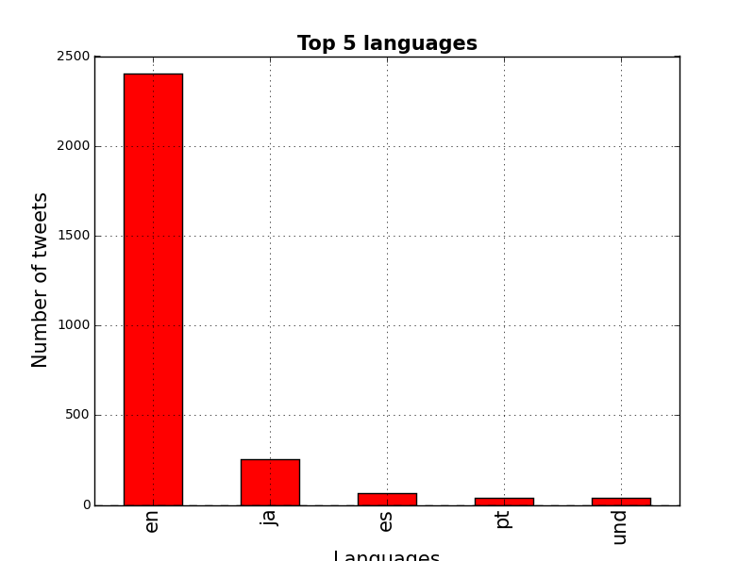
Results

Slide 7
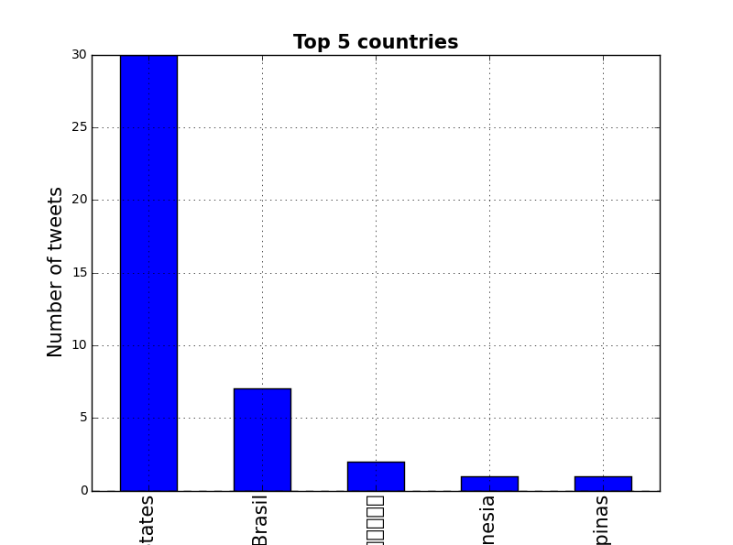

Slide 8
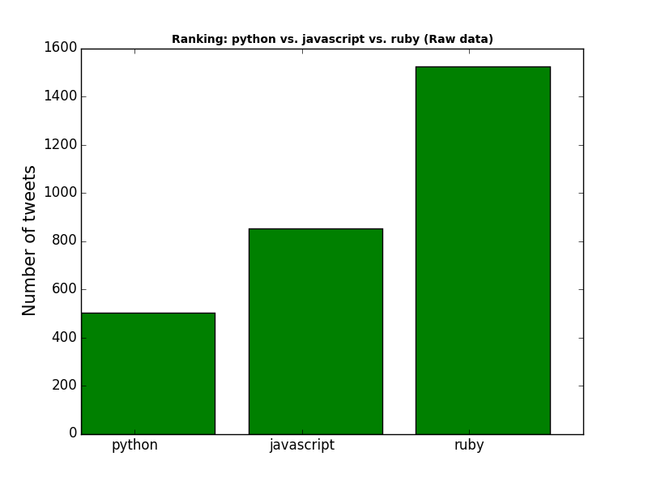

Slide 9
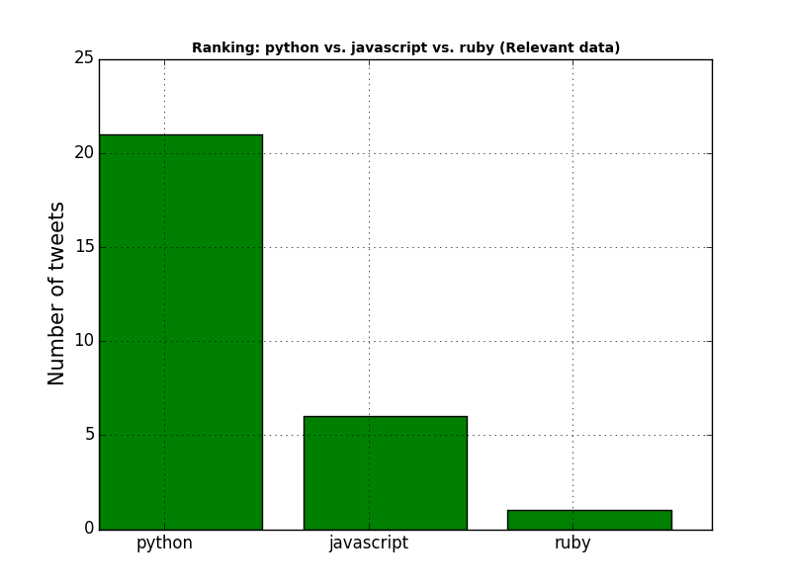

Slide 10
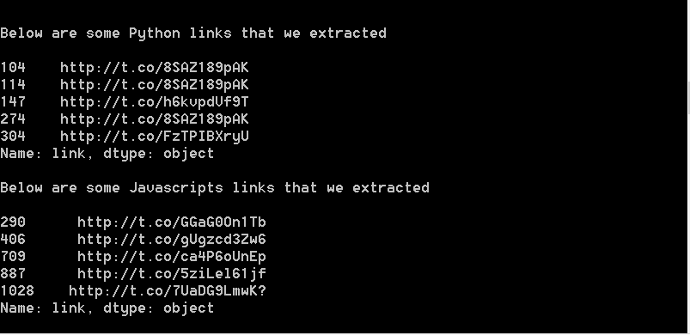
Links Extracted

Slide 11

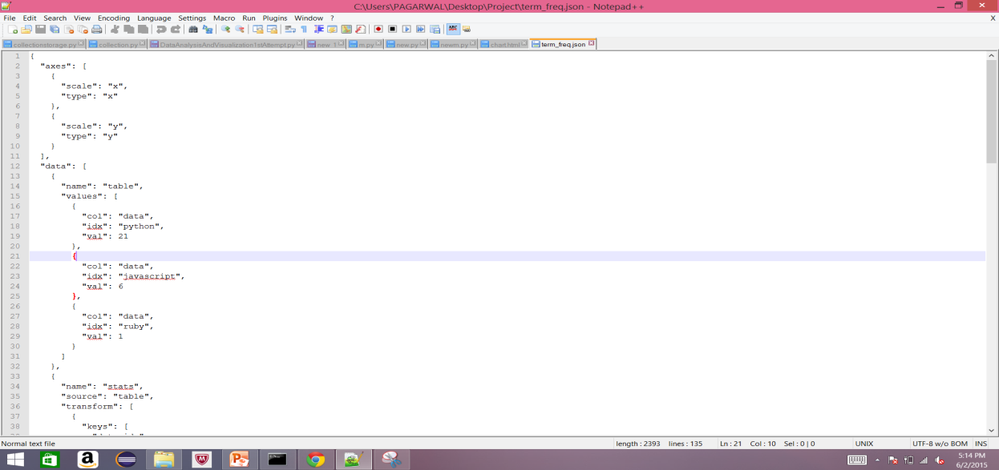
The file term_freq.json will contain a description of the plot that can be handed over to D3.js and Vega. A simple template (taken from Vincent resources) to visualise the plot:
Save the above HTML page as chart.html and run the simple Python web server:

Slide 12

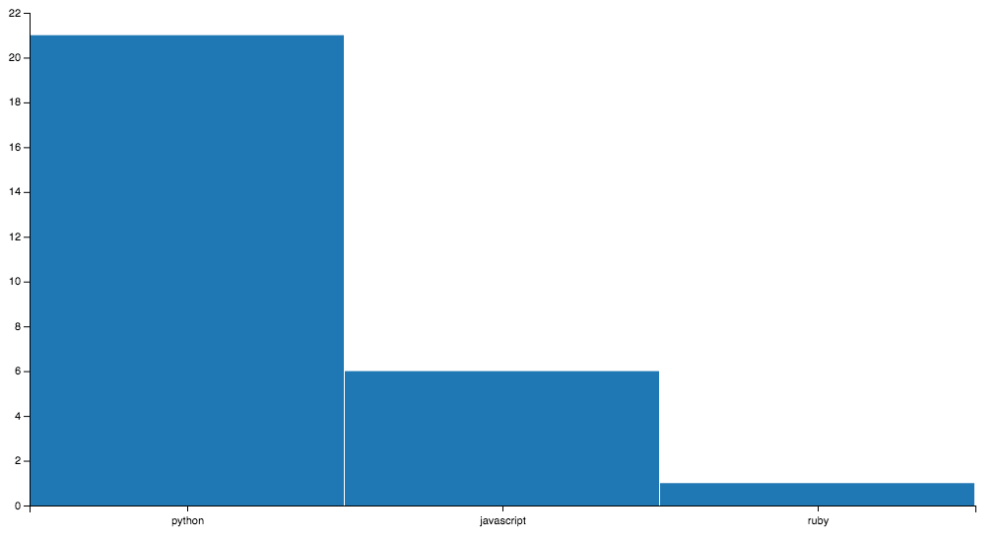
Result
On opening the browser and observe the result:

Slide 13
Thank You

